Slide 1
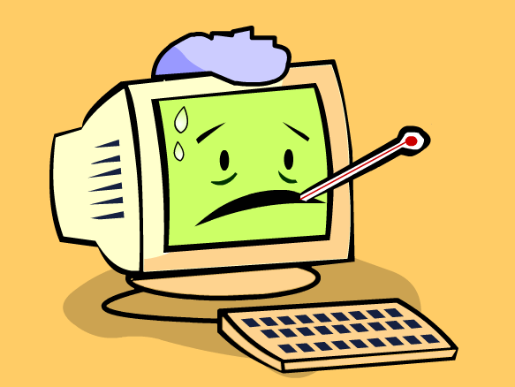
A Powerpoint Presentation on “COMPUTER VIRUSES”
Done by:-
S Vinay T Manikanta CSE-D

Slide 2
Contents
What is a computer virus?
Who created a computer virus?
Different types of computer viruses.
What does a computer virus do? Symptoms of computer virus.
Sources of computer virus attack.
What is an antivirus? Different antivirus software.
Prevention from computer virus.
Conclusion.

Slide 3
What is a computer virus?
A computer virus is a software program with an ability to make copies of itself that attack other applications or files in our system.
In simpler words, a computer virus is an illegal computer code that can do such things as alter programs or destroy data. As virus can copy itself onto the programs, it thereby spreads its damaging effects.

Slide 4
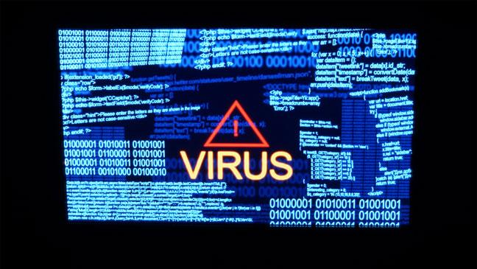
Who created a computer virus?
The first ever computer virus was developed in 1986 by two Pakistani brothers in Lahore Pakistan. The first computer virus named "Brain" was designed by Amjad Farooq Alvi and Basit Farooq Alvi with the intention of determining the piracy of a software written by them.

Slide 5
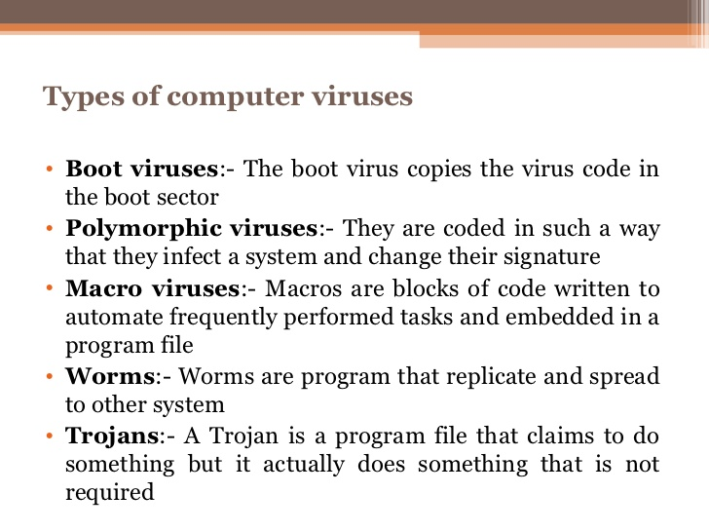

Slide 6
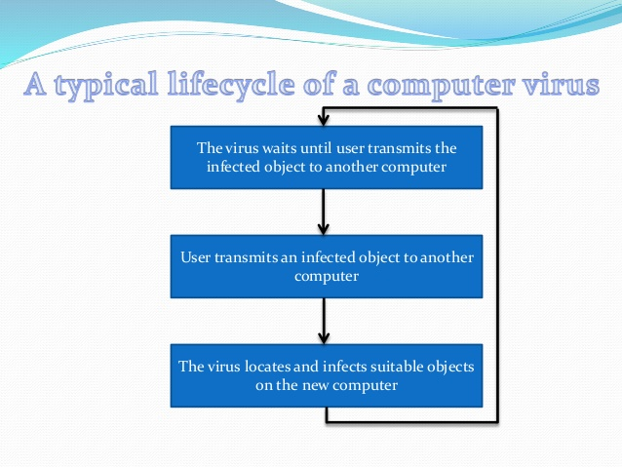
What does a computer virus do?

Slide 7
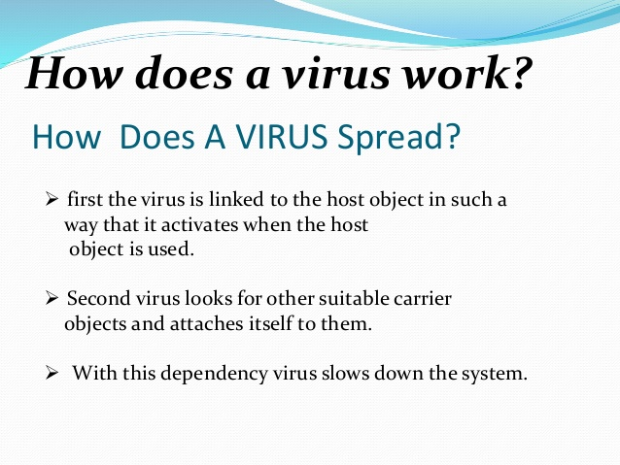

Slide 8
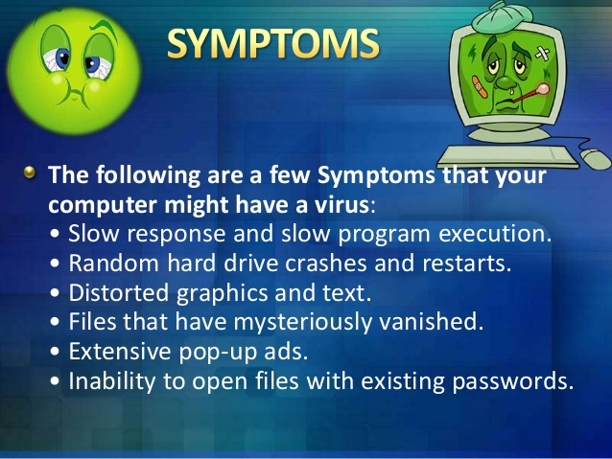

Slide 9
Sources of Computer Virus attack.
#1.Downloadable Programs
One of the main sources of virus attacks is through downloadable programs found on the web. Mainly, these harmful downloadable programs abound on unreliable sources and internet news groups. The programs may include downloadable files, which is the commonest source of malware, and others like freeware, games, screen savers and many executable files. #2.Cracked Software
Another common source of malware are cracked software. Inherently, cracked software will at one time or the other prove to be harmful especially to people who consistently go for cracked, and/or illegal, software from the internet. As a result, it is recommended that while downloading software from the internet, always go for download sources that are legal and appropriate in order to protect yourself.

Slide 10
#3.Internet - Possible Source of Viruses and Spyware
The Internet is another possible source of virus and spyware attacks. There is a genuine source of attacks there but should not stop people from accessing the internet. Basically, access to the internet enables access to various sites. Whereas some of the sites could be good, others could be harmful leading to serious infections. Sometimes it is hard to notice when viruses and spyware attack the computer systems, and therefore, while visiting harmful sites, which could be pleasing to users, most computer users may not be aware of what is going on in their computer. The spyware may land into your computer when after visiting a given website, you see a popup asking you permission to download an application and you click yes the spyware gets downloaded to your system. These popups normally make you provide not only your personal preferences but also your computer resources such as your internet connection bandwidth together with computer processing time and you do not get anything in return but more advertisements.

Slide 11
#4.Email Attachment
Email attachments are also common sources of computer malware. Mainly, the viruses are attached to an email in order to meet a certain purpose. Generally, these viruses are sent by a third party, and after opening the attachment your computer is attacked by the viruses. As a result, it is important that you handle email attachments with extreme care especially when they originate from unknown senders. #5.Booting from Unknown CD
A computer gets infected from the CD while the computer is starting, if the CD is infected with virus. It is therefore good practice to always remove a CD while the computer system is not on since lack of removing the CD after switching the computer system off, brings on high possibility of the computer system booting automatically from the disc. While booting, the CD may enhance a chance to install along with launching files and programs on a particular computer systems. This will result to harming the computer system.

Slide 12
#6.Sharing Files
Similarly, file sharing networks such as Barshare, Limewire, and Kazaa could also be possible sources of virus attacks. This is more so because while installing files from the said sources, files or programs may be launched on a specific computer system that may be harmful to the system. Moreover, virus and spyware attacks can also come from sharing of files using FLASH DRIVES. This is especially so when the flash drive is infected with a virus or a spyware, or when the flash drive is taking the files from an infected computer system.
Before inserting an external drive, whether a CD, a flash drive, or a hard disk, it is always important to scan through it before deciding to open it to continue with your desired purpose. Another crucial process that is normally done on the external drives with little memory is formatting after one is through with the information in them. Formatting deletes the viruses and spyware and this keeps these drives safer to use again.

Slide 13
What is an Antivirus?
Anti-virus software is a program or set of programs that are designed to prevent, search for, detect, and remove software viruses, and other malicious software like worms, trojans, adware, and more.
Best Antivirus software:
Norton Antivirus 4. Avast Antivirus.
McAfee Virus Scan. 5. Quick Heal Security Solutions.
Kaspersky Antivirus.
Always be sure you have the best, up-to-date security software installed to protect your computers, laptops, tablets and smartphones.

Slide 14
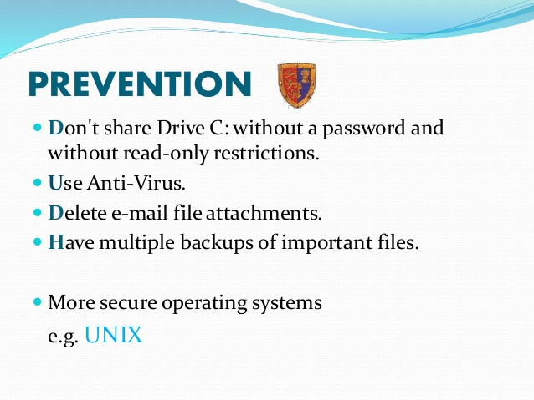

Slide 15
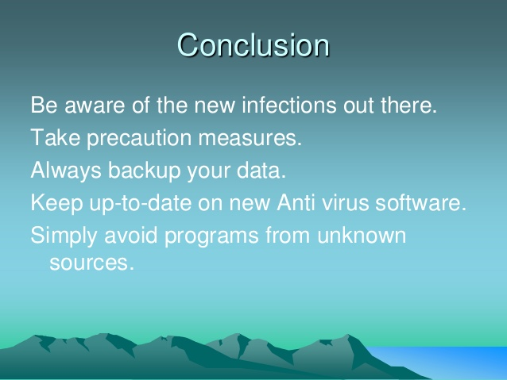

Slide 16


Slide 17


